Slide 1

HÀNG HƯ SRDL-SSDL
01PL2507152

Slide 2
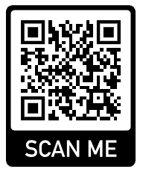
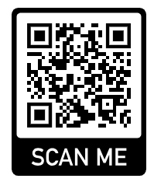
WIFI XA
WIFI USER
MperObOtXA@141516

Slide 4
